Slide 1



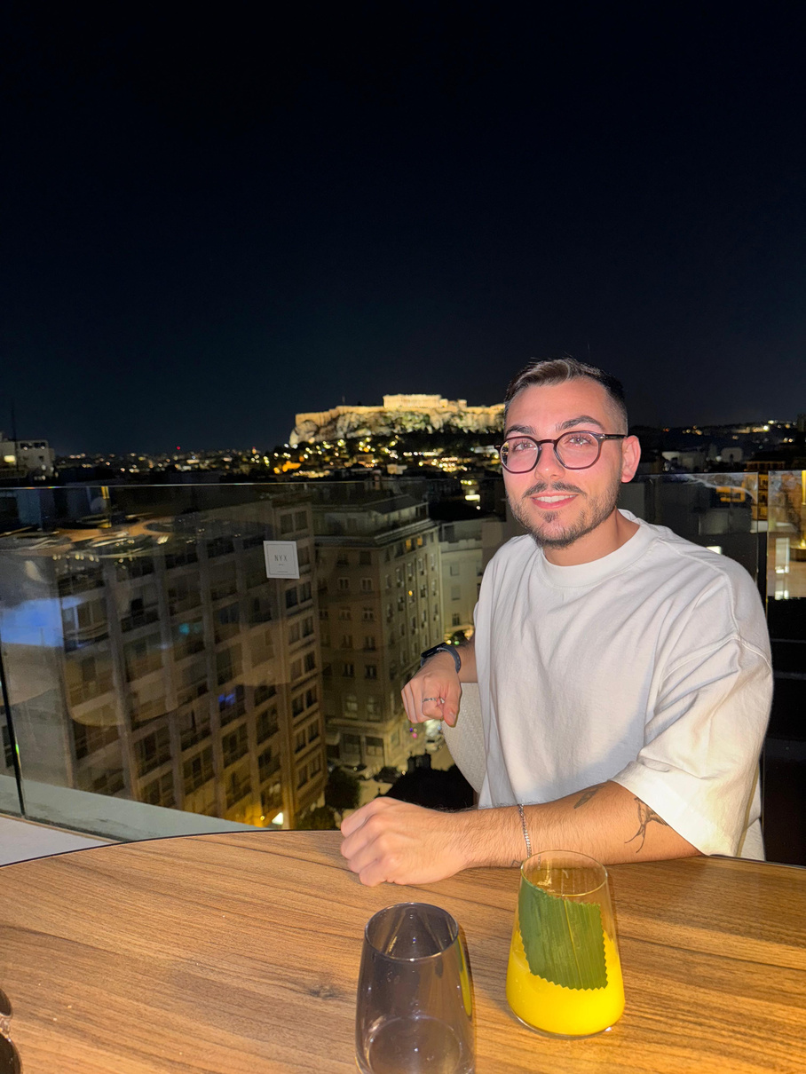

SE-B-8
Software Engineering
Students: Tal Israel Refaelov and Gal Yossef
Advisor: Ms. Alona Kutsyy
PROBLEM DEFINITION
SAFEZONE
Children and vulnerable groups often lack immediate support and clear guidance in crises, increasing stress and reducing resilience.
SOLUTION DESCRIPTION
A mobile app built with React Native and Firebase, integrating:
Shelter detection via map
AI-powered emotional support chatbot
Volunteer network management
Child-safe modes
INTRODUCTION
SafeZone is an emergency app that provides alerts, shelter locations, emotional support, and volunteer connections — all in one place.
GOALS
Fast emergency support, volunteer connections, real-time alerts, AI emotional help, and stronger communities.
Tal Refaelov
Gal Yossef

Slide 2
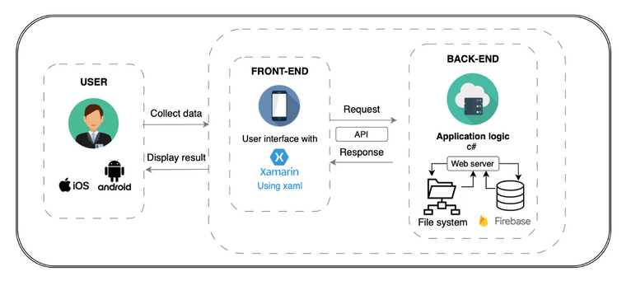
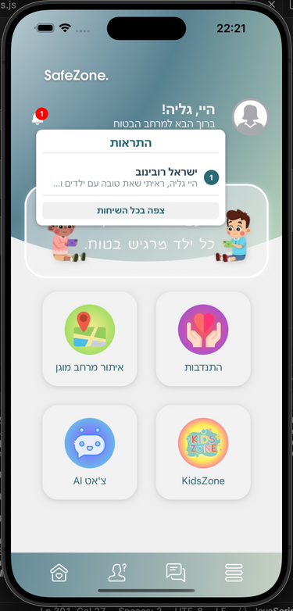
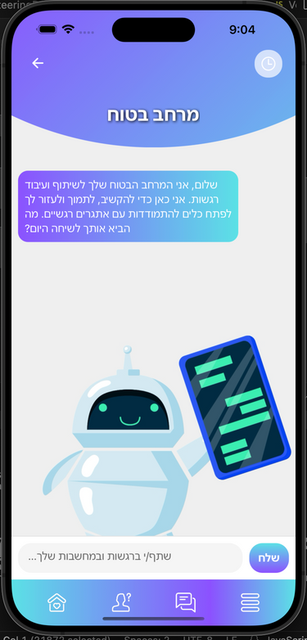
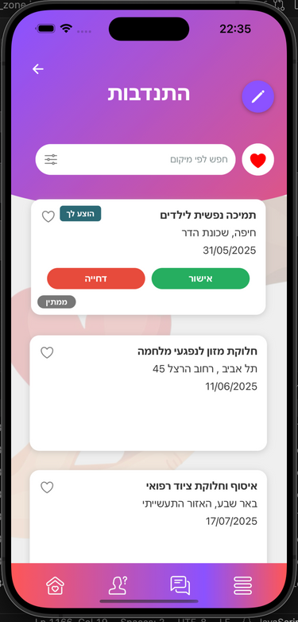
SE-B-8
Software Engineering
Students: Tal Israel Refaelov and Gal Yossef
Advisor: Ms. Alona Kutsyy
SYSTEM ARCHTIECTURE
IMPORTANT SCREENS
METHOD
Built with React Native and Firebase, SafeZone includes:
• Google Maps shelter locator
• AI emotional support chatbot
• Volunteer network management
• Child-safe design & data protection
CONCLUSIONS
SafeZone enhances emergency response by delivering real-time alerts, emotional support, and community connections in an easy-to-use app.

